Slide 1
Welcome to our presentation
.

Slide 2




OUR TEAM
Al-Mamun
Md. Robiul islam
Riad shalehin leon​
Sakhawt hosen
ID: 191-15-2576
ID; 191-15-2611
ID:191-15-2613
ID:191-15-2586

Slide 3
Topic: maximum likelihood estimation

Slide 4

What is Maximum likelihood estimation?
Maximum likelihood estimation is a method of estimating the parameters of an assumed probability distribution, given some observed data. This is achieved by maximizing a likelihood function so that, under the assumed statistical model, the observed data is most probable.

Slide 5

Five Major Steps in MLE:
Perform a certain experiment to collect the data.
Choose a parametric model of the data, with certain modifiable parameters.
Formulate the likelihood as an objective function to be maximized.
Maximize the objective function and derive the parameters of the model.

Slide 6
uses of maximum likelihood estimation
We can use MLE in order to get more robust parameter estimates. Thus, MLE can be defined as a method for estimating population parameters (such as the mean and variance for Normal, rate (lambda) for Poisson, etc.) from sample data such that the probability (likelihood) of obtaining the observed data is maximized.

Slide 7

MLE Uses
This model is used to estimate the likelihood of possible trees, by multiplying the estimated probability of each mutation event implied by the tree.
The Maximum Likelihood Estimator is the value is that maximize our Parameter, θ.
Value of θ that maximizes L (θ| x1,x2….xn)
Can Apply MLE to different types of distributions ( normal. Binomial, Position etc).
Coin-filp example (binomial distribution).
Find parameters that give you that the highest likelihood of your observed coin-flips.
Despite the fact that a number of recent studies assert that the method of concatenating multiple gene data before phylogenetic analysis works

Slide 8
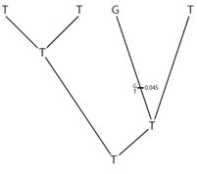
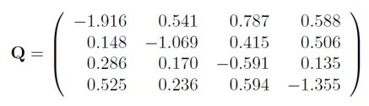

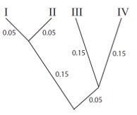

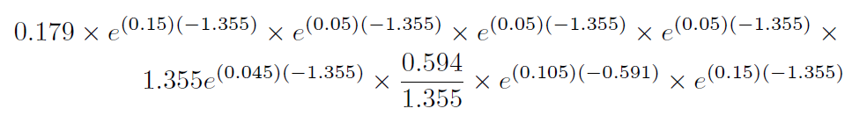

Maximum Likelihood Estimation Data (Example)​
History (Given)
πA = 0.138, πC = 0.188, πG = 0.495, πT = 0.179​
=
Branch Length (Given)​

Slide 9
1. maximum likelihood estimation in wireless sensor networks 2. Development of stock correlation network models using maximum likelihood method 3. Sparse logistic maximum likelihood estimation for optimal well-being determinants
Research sector use
.

Slide 10

Future scope :
Maximum liklihood estimation in CFA models in maximum liklihood. Software programs but is outside the scope of the study. Maximum liklihood estimation future research assessing the effect of various the indicate. Maximum liklihood estimation is the present limitations and expected realistic the future development. To further facilities large polygenetic analyze we also consider the future development of IQ.

Slide 11
References​
1.Yang, Z. I. H. E. N. G., Nick Goldman, and A. Friday. "Comparison of models for nucleotide substitution used in maximum-likelihood phylogenetic estimation." Molecular biology and evolution 11.2 (1994): 316-324.​
​
2.Richards, Francis SG. "A method of maximum‐likelihood estimation." Journal of the Royal Statistical Society: Series B (Methodological) 23.2 (1961): 469-475.​
​
3.Lokshin, Michael, and Zurab Sajaia. "Maximum likelihood estimation of endogenous switching regression models." The Stata Journal 4.3 (2004): 282-289.​
​
4.Karras C, Karras A, Avlonitis M, Giannoukou I, Sioutas S. Maximum likelihood estimators on MCMC sampling algorithms for decision making. InIFIP International Conference on Artificial Intelligence Applications and Innovations 2022 (pp. 345-356).

Slide 12

THANK YOU
.

